Slide 1
Homework 4 How to do it in SPSS

Slide 2
Open the data file
Get the data file (from Github or myBU) and put it in a directory where you can find it later).
Open the data file (Homework4_data_spss.csv) by selecting “Read Text Data…” from the File menu.
This will open the Text Import Wizard
(For the assignment, an SPSS .sav file is provided, so you can skip this step)

Slide 3
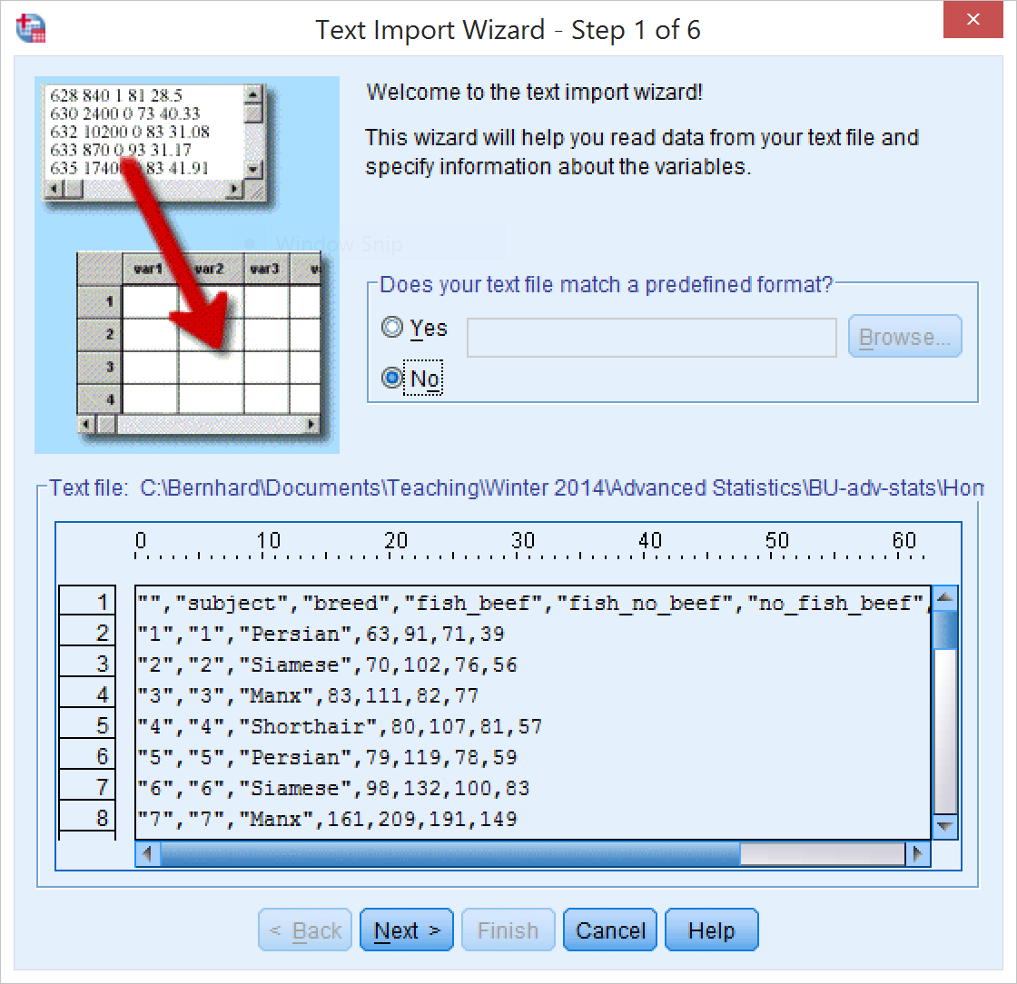
Text import wizard
Press Next

Slide 4
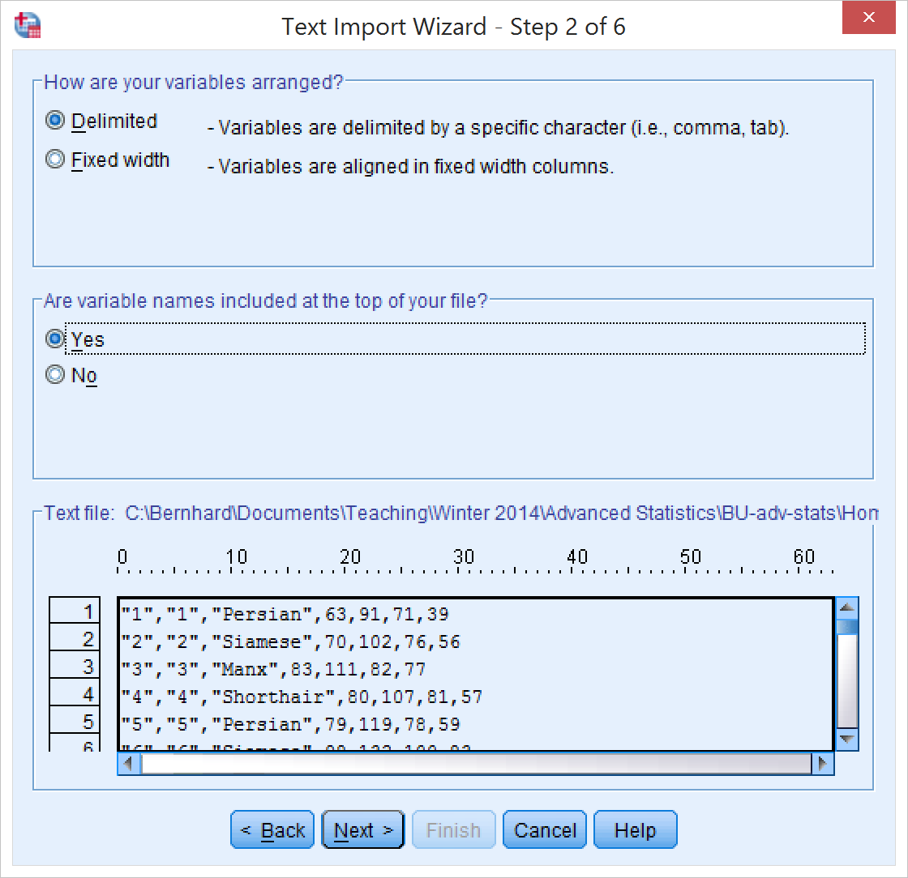
Text import wizard
Select “Delimited” (since the data are comma delimited)
Select “Yes”, since the first line contains column names
Press Next

Slide 5
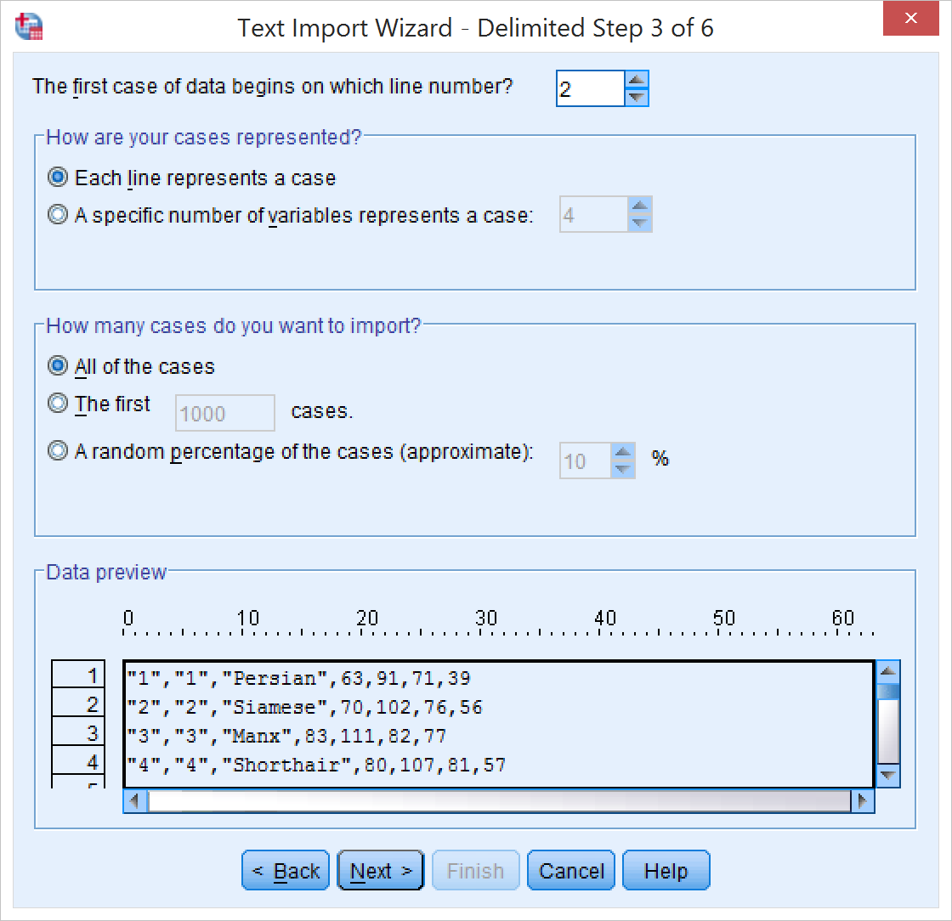
Text import wizard
These values should be correct, but double-check:
First case of data begins on line 2
Each line represents a case
Import all of the cases
Press Next

Slide 6
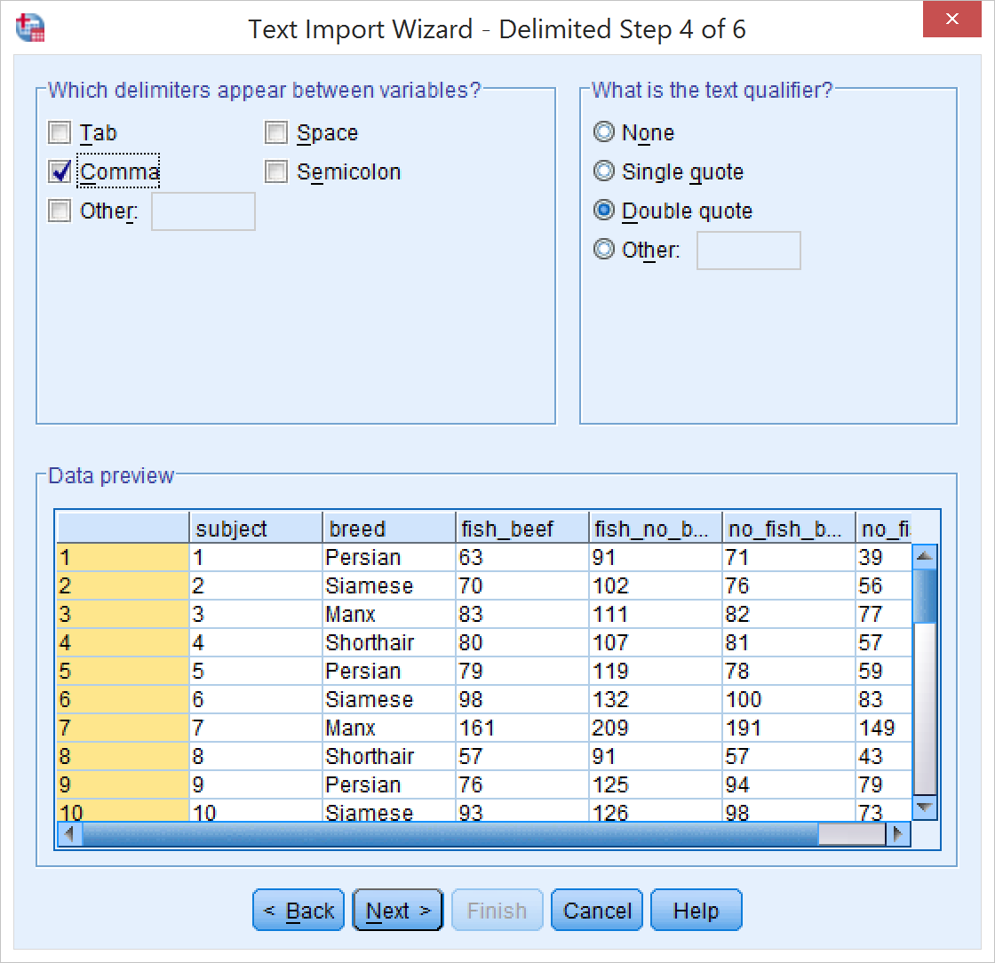
Text import wizard
These values should be correct, but double-check:
Delimiters that appear between variables are commas (and nothing else)
Text qualifier is Double quote
Press Next

Slide 7
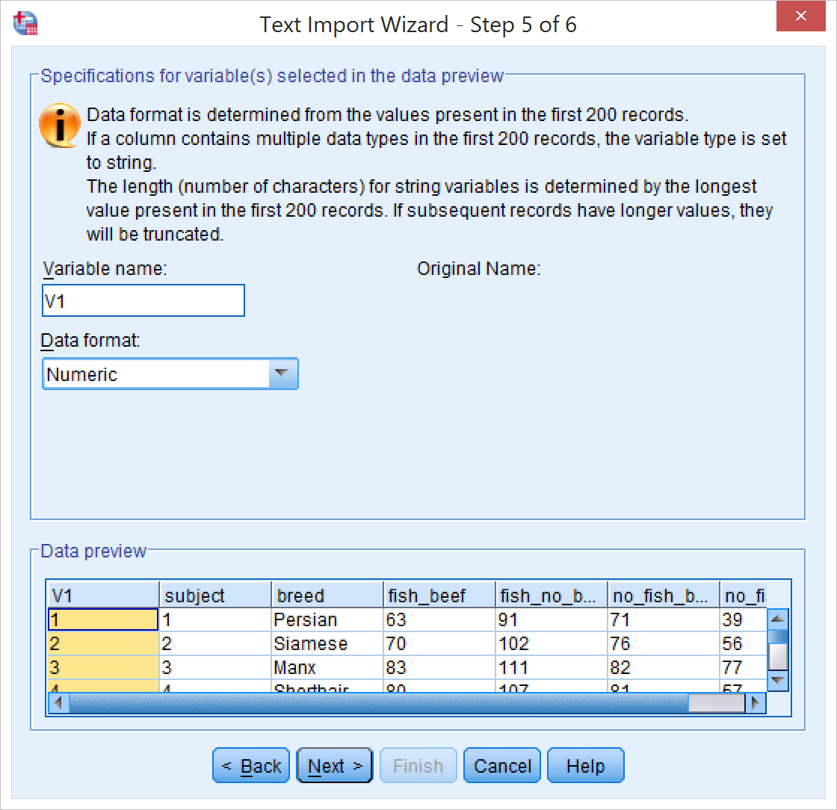
Text import wizard
SPSS may complain about invalid variable names, but it fixes them just fine.
Press Next, then Finish.

Slide 8
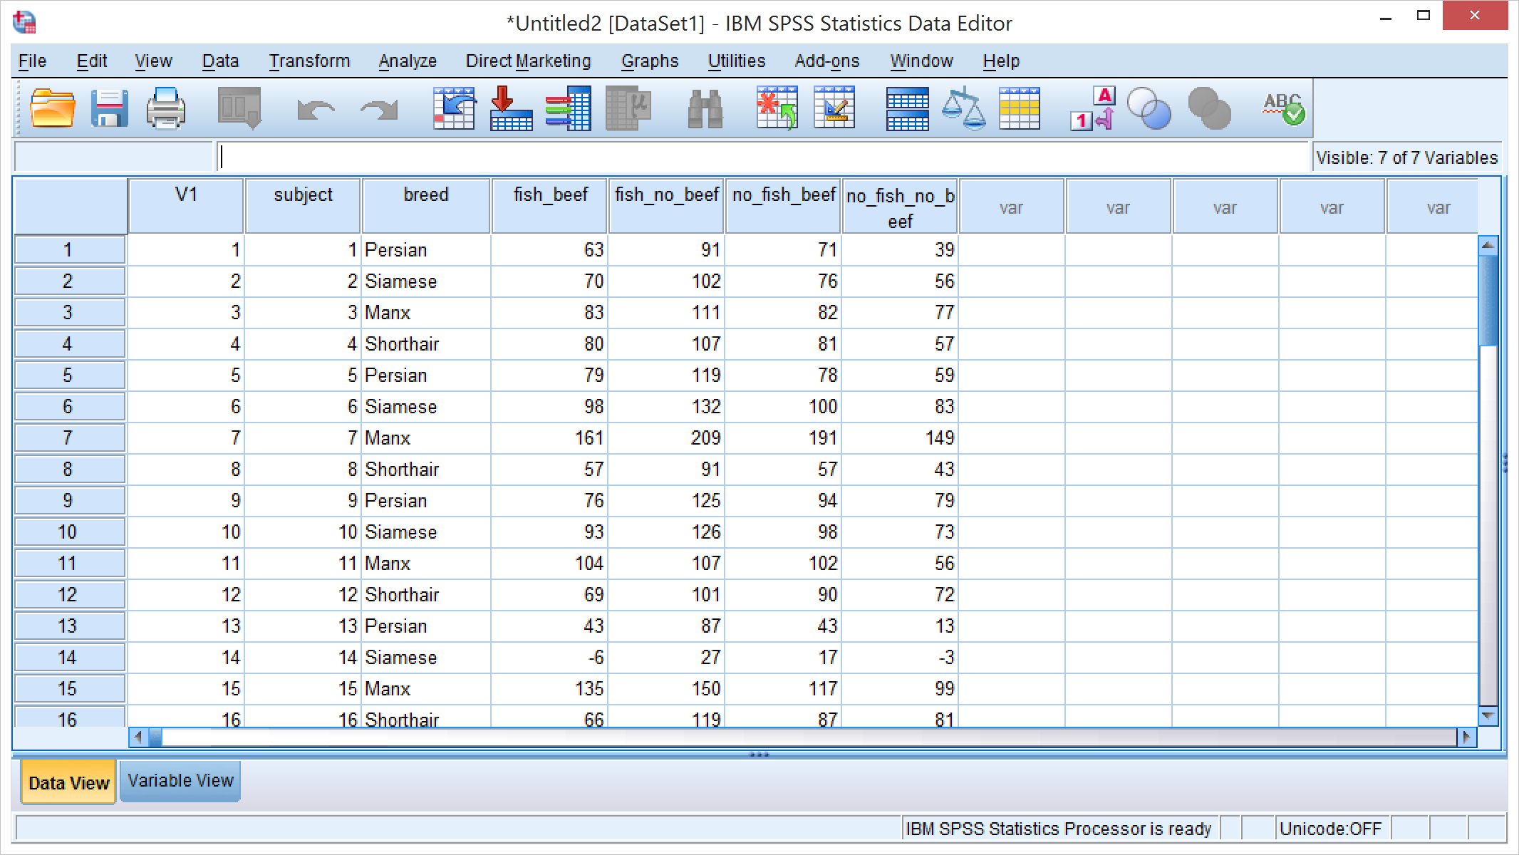
Data View
Your data should now be imported like this.
You can clear the “V1” and “subject” variables if you want (but they don’t hurt either)

Slide 9
Recode breed into a discrete factor
From the Transform menu select “Automatic Recode…”
(If you are working from the SPSS .sav file for the assignment, you can skip this step).

Slide 10
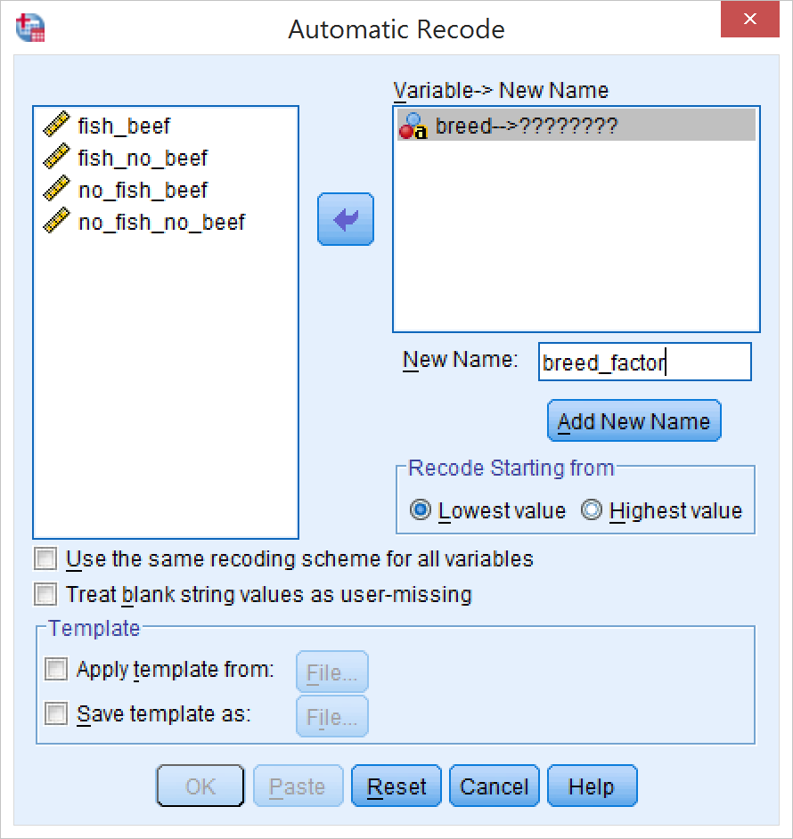
Recode breed into a discrete factor
Select “breed” from the list on the left and click the arrow to move it to the right
Enter a new name for the recoded variable
Recode starting from “Lowest value” is fine for our purposes
This will assign a different number to each breed, starting alphabetically (i.e. with Manx).
Click “Add New Name” and then OK

Slide 11
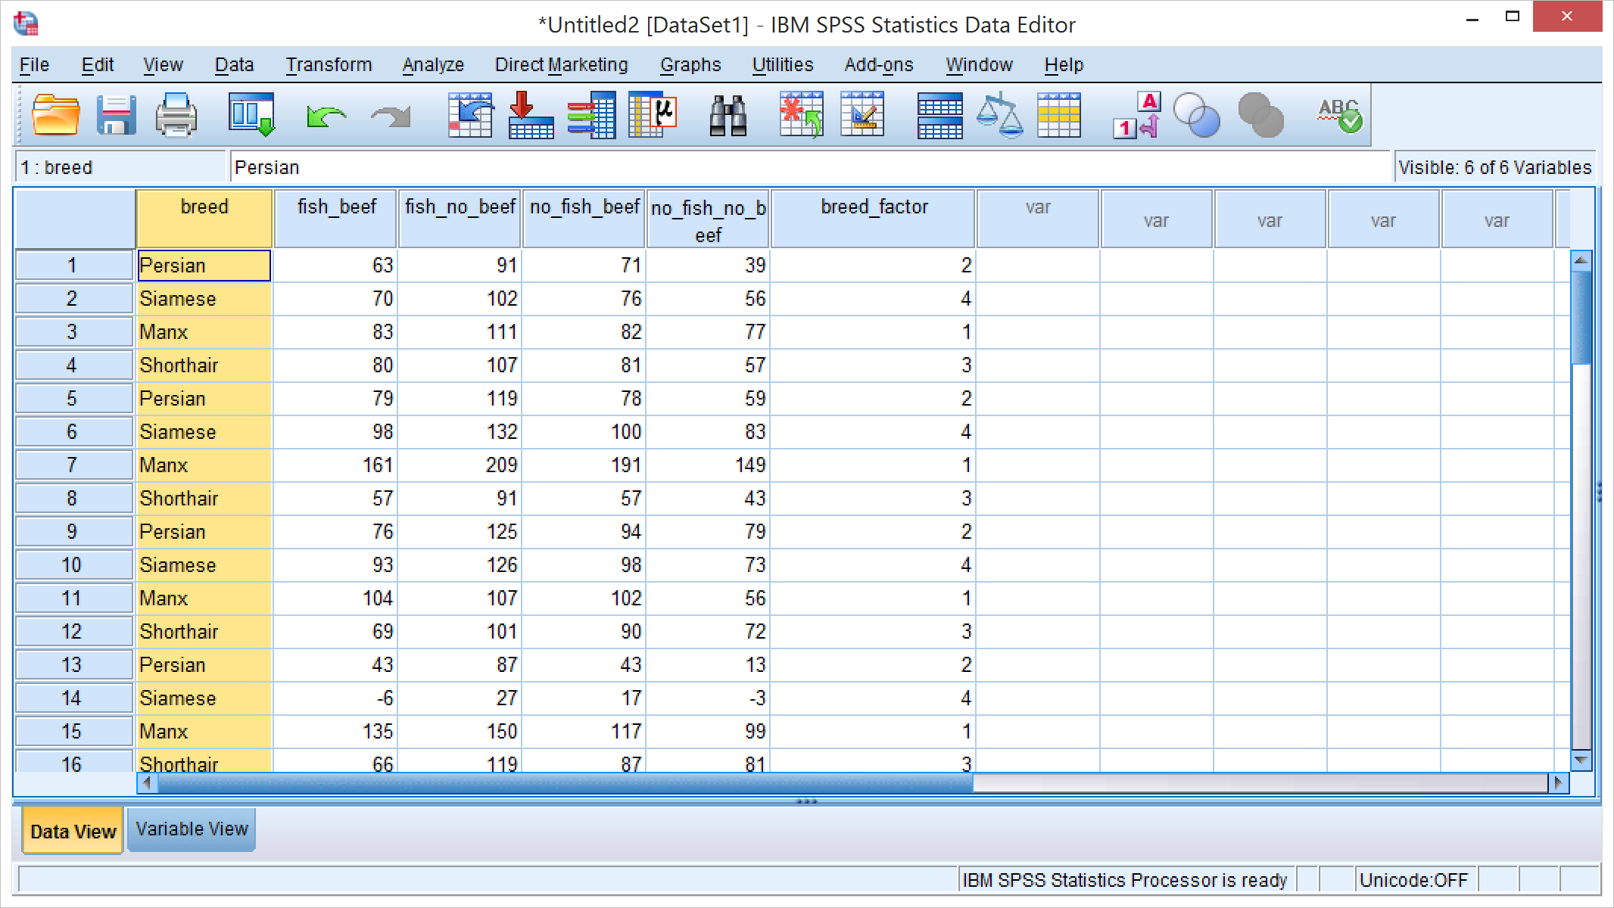
You should now have a new variable “breed_factor”

Slide 12
Run the analysis
From the Analyze menu, select General Linear Model and Repeated Measures…

Slide 13
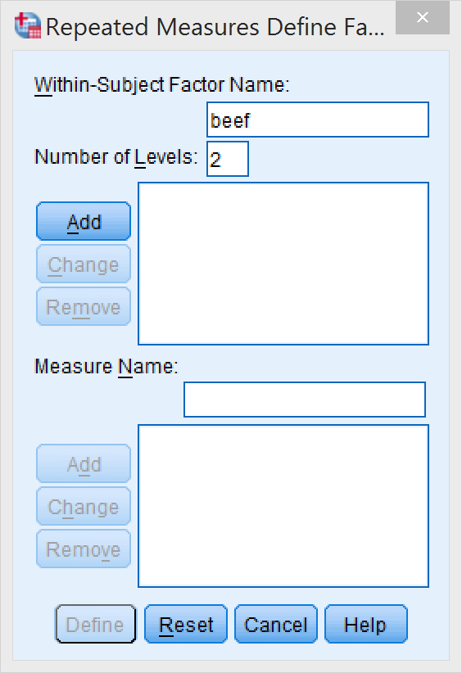
Run the analysis
First, you have to re-code the data (i.e. split the columns back up into the two within-subject factors)
Add the name for the first factor (“beef”) and the number of levels (2)
Click “Add”

Slide 14
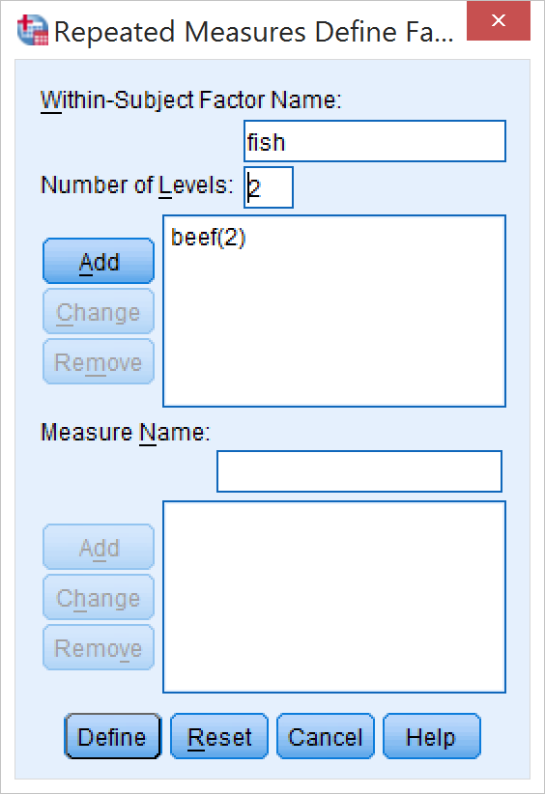
Run the analysis
Add the name for the second factor (“fish”) and the number of levels (2)
Click “Add”

Slide 15
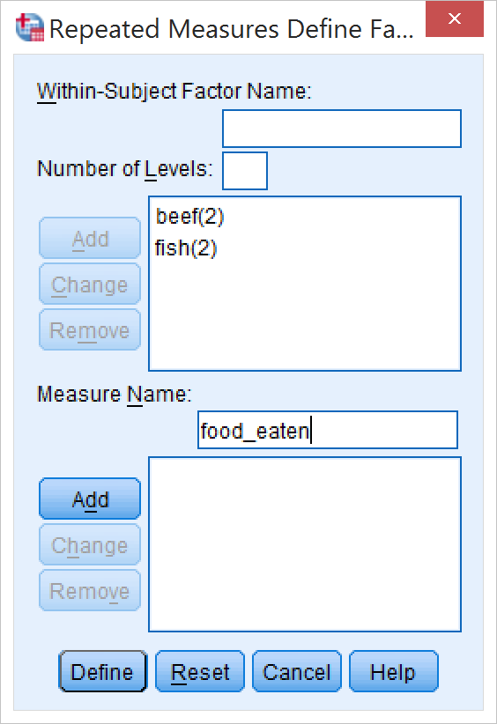
Run the analysis
Add a name for the dependent measure (e.g. “food_eaten”)
Click “Add” and “Define”.

Slide 16
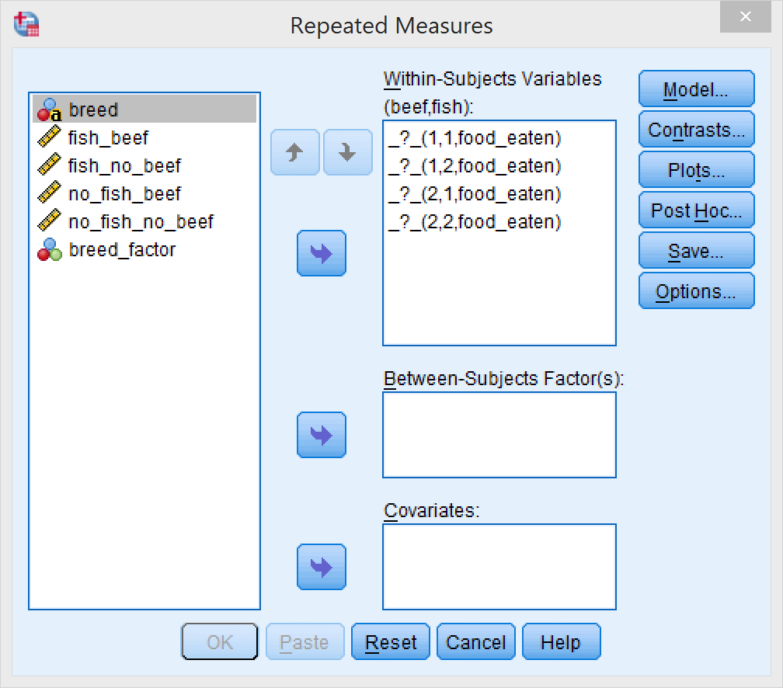
Assign within-subjects variables
Click each corresponding level of the within subjects variables, then on the column name on the left, and then on the arrow to assign it.
You need to decide which level corresponds to which numbers
e.g. 1,1 could correspond to beef, fish and 2,2 could correspond to no fish, no beef, 1,2 could correspond to beef, no fish, and 2,1 could correspond to no beef, fish
If you get this wrong, you’ll be very confused later if there’s an interaction!

Slide 17
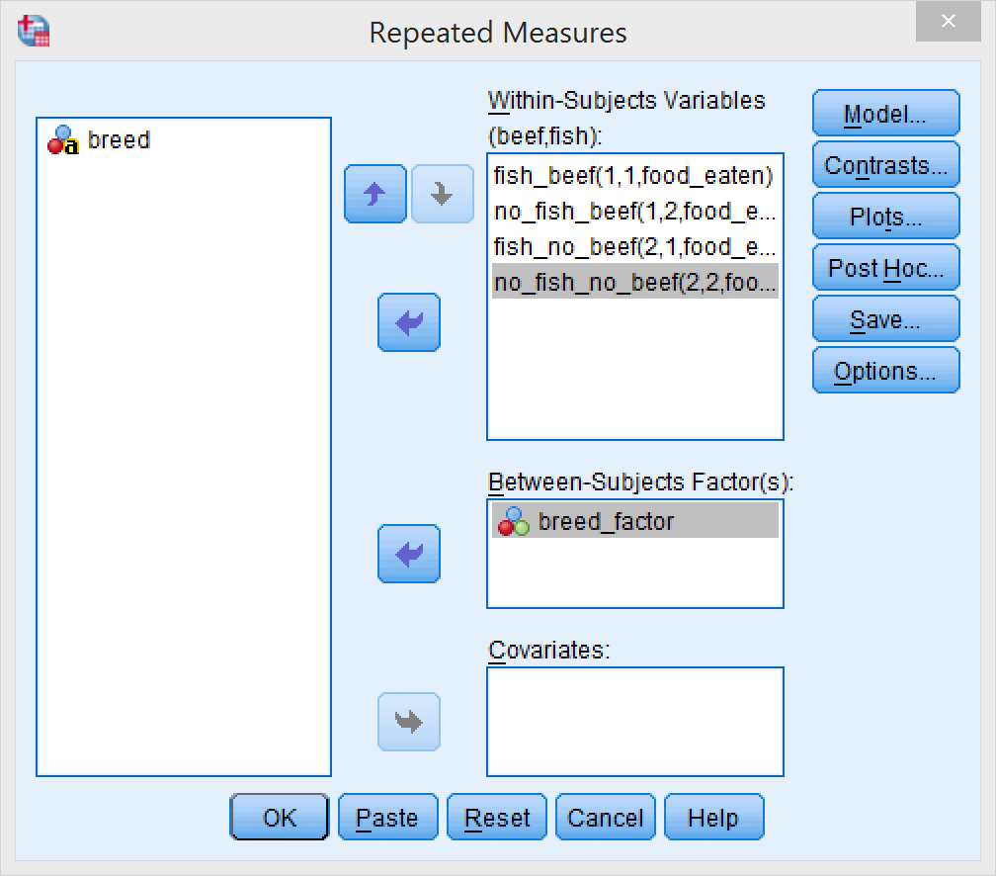
Assign between-subjects factor
Assign the recoded factor (breed_factor) to the Between-Subjects Factor(s) field.

Slide 18
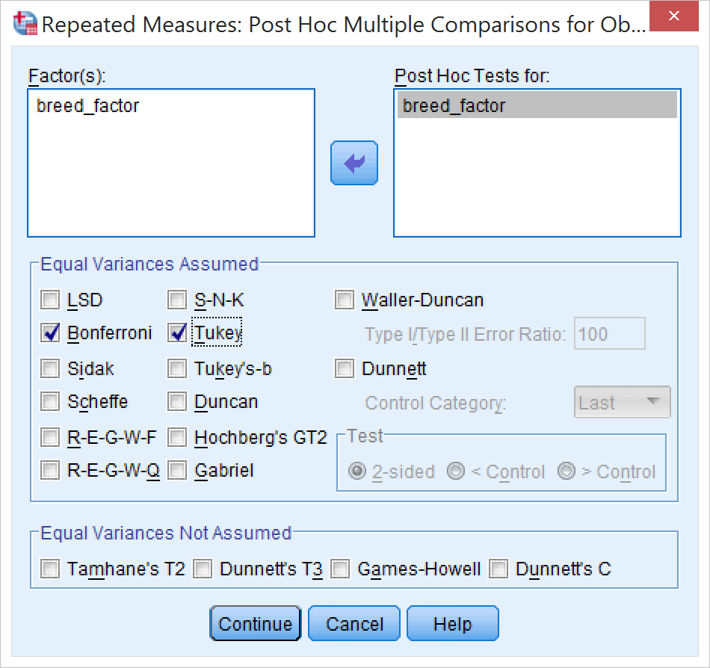
Post-hoc comparisons
Click “Post Hoc…”
Note that only factors with 3 or more levels are shown in the post hoc window
Select “breed_factor” and move it over to the “Post hoc tests for” field
Select any tests you want, e.g. Bonferroni and Tukey
Click “Continue”

Slide 19
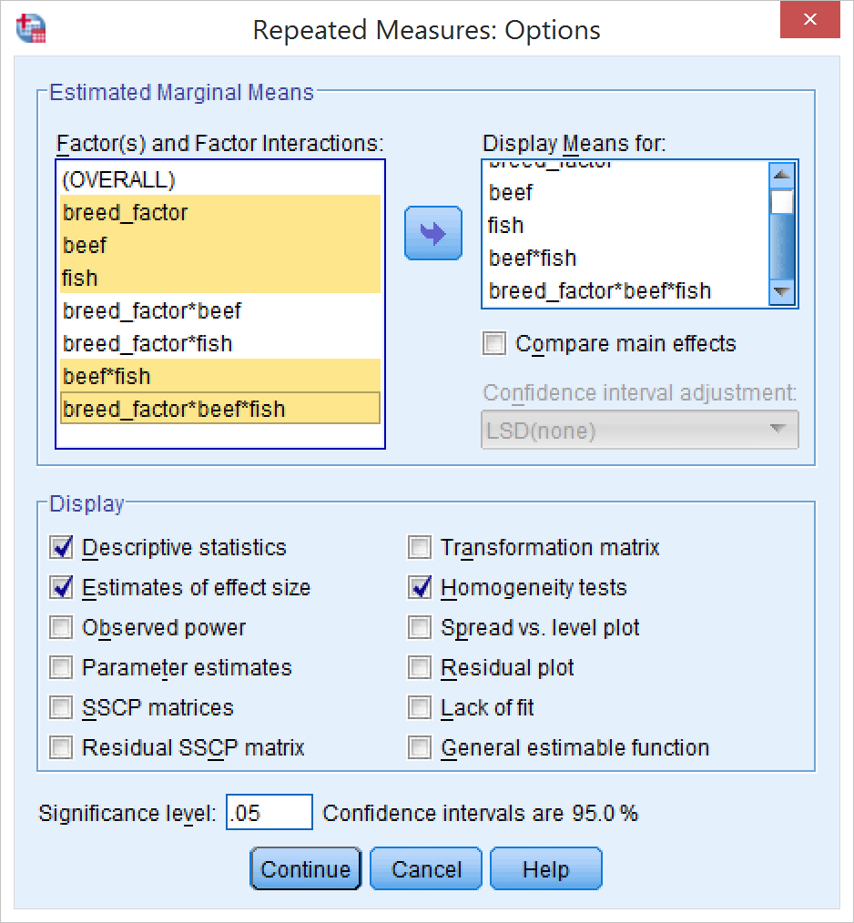
Options
Click “Options…”
Get marginal means for all main effects and the three way interaction (the two-way interactions are less interesting)
Get descriptive statistics and estimates of effect size
Get homogeneity tests
Click “Continue”
Click “OK” to run the analysis.

Slide 20
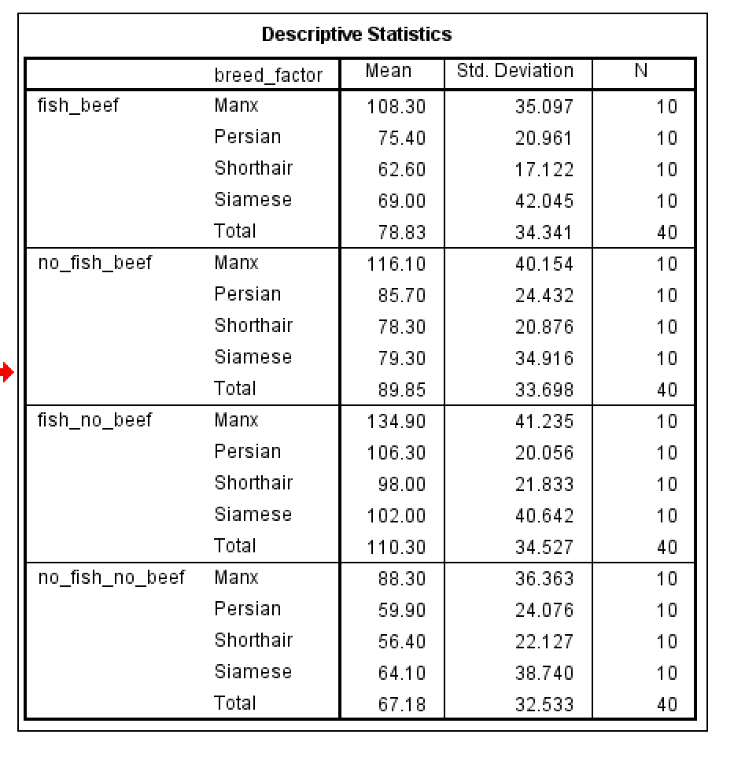
Output
Here you have (almost) everything you need for your homework report
First, get the descriptive statistics table
You can edit this table by double-clicking on it

Slide 21
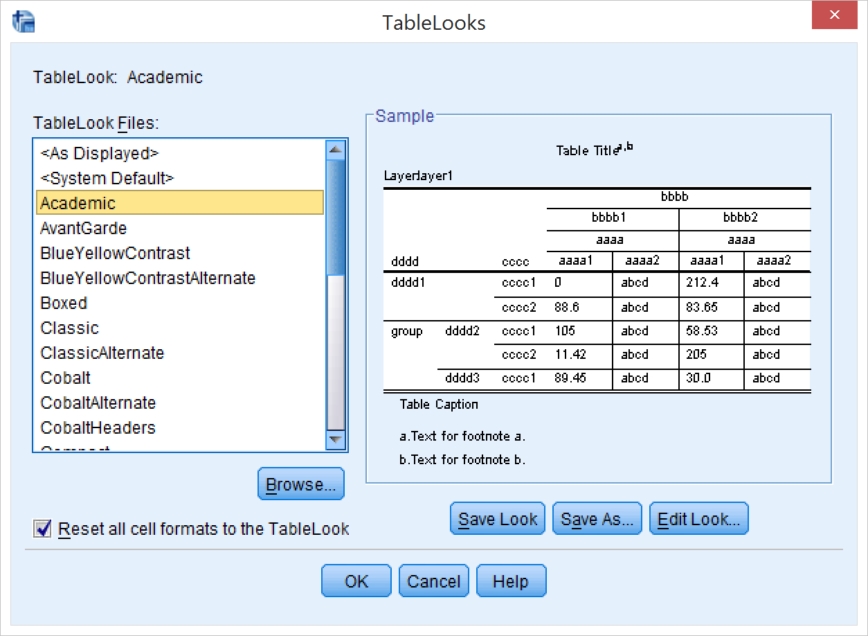
Output
After double-clicking the table, right-click it and select TableLooks…
Select “Academic”
This will remove all vertical lines
According to APA style, tables should not have vertical lines.

Slide 22
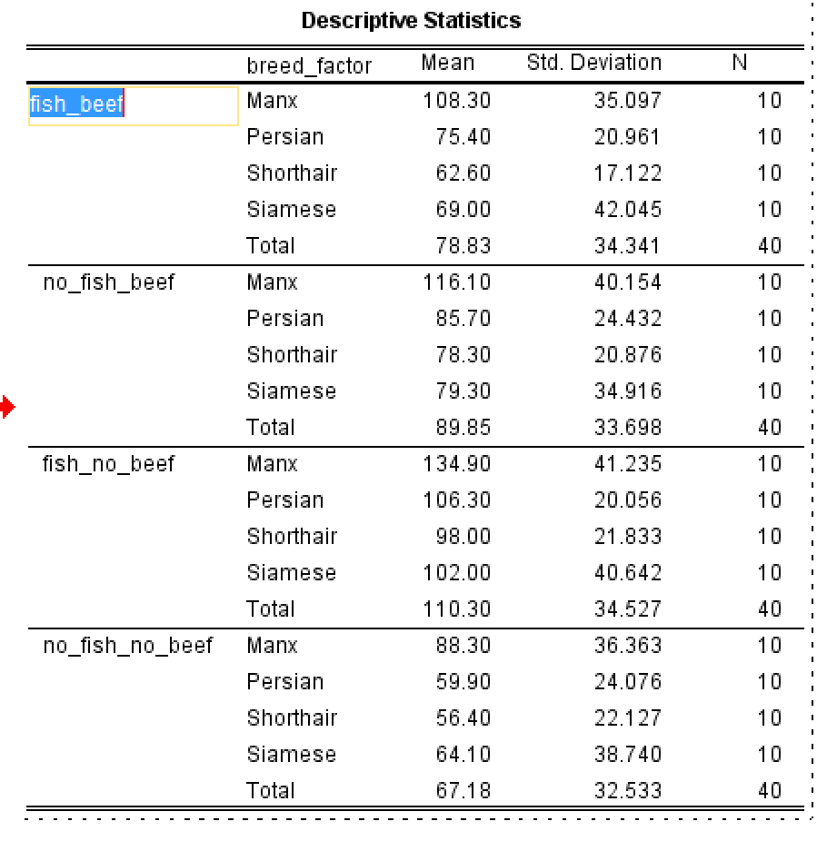
Output
Still in the table editing mode, double-click on the condition labels to edit them into something nicer-looking

Slide 23
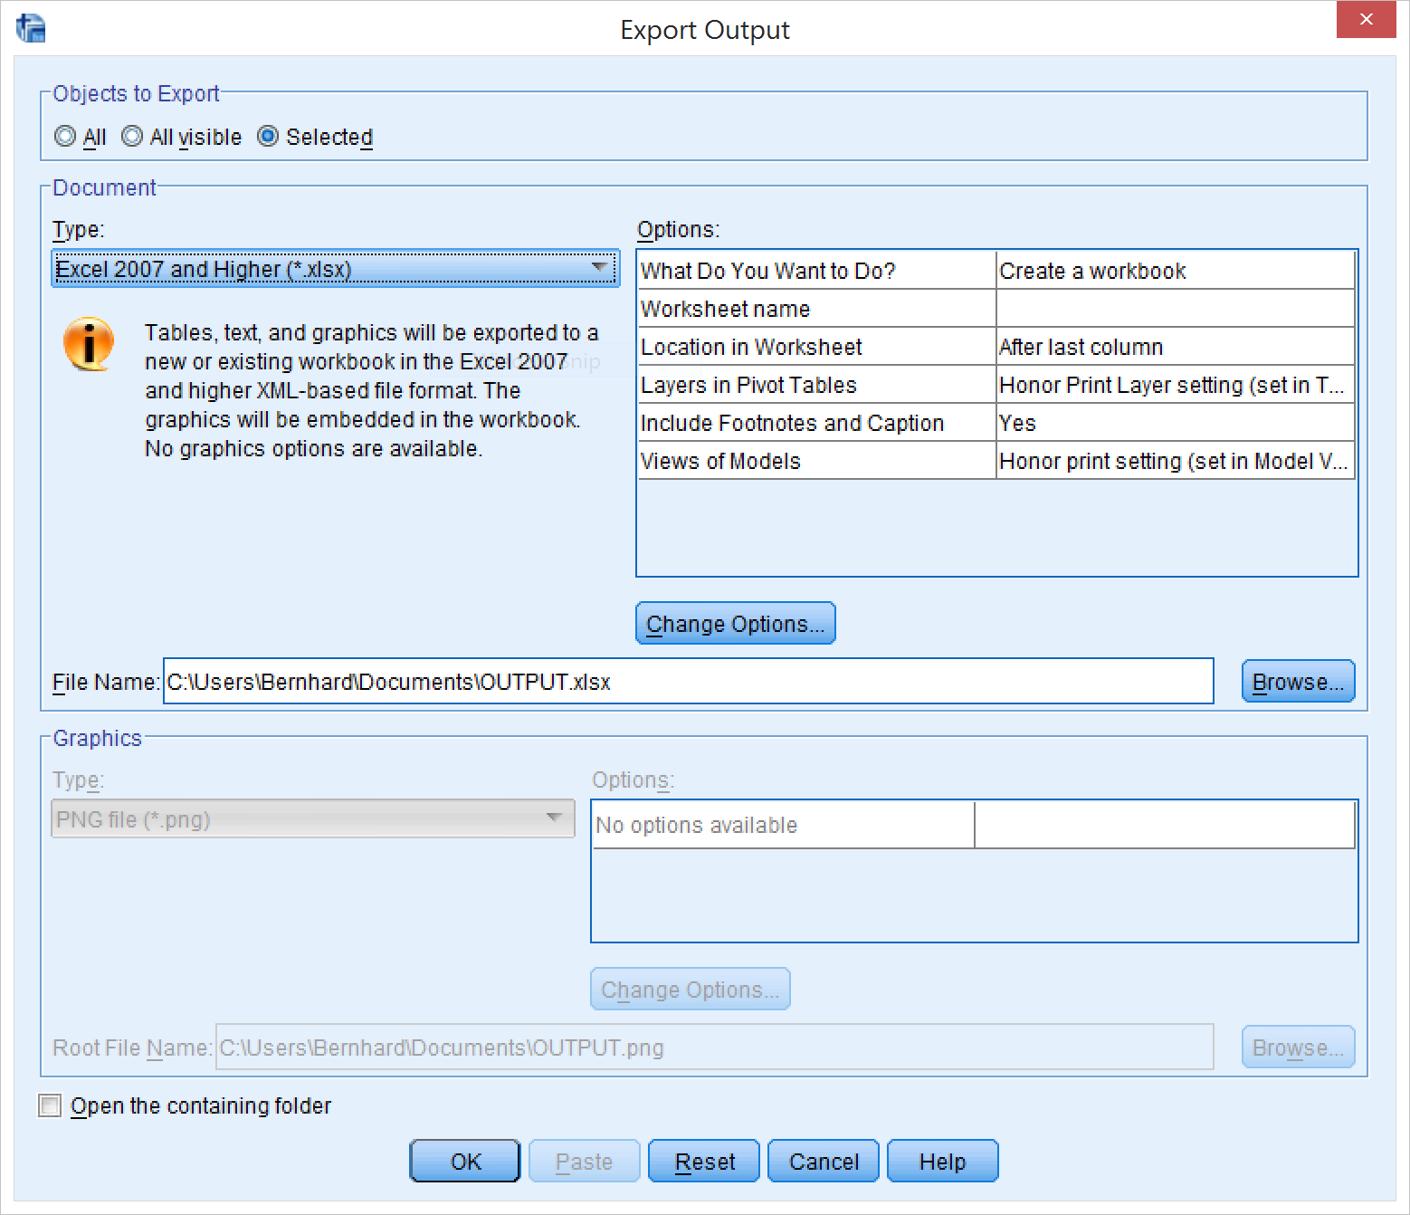
Output
Now it’s time to get this table in Excel (and then in Word). Exit the table edit mode by clicking outside it, then right-click it and select “Export…”
Select a file name and path that you can find again later on…
Click OK.
Now open the file in Excel

Slide 24
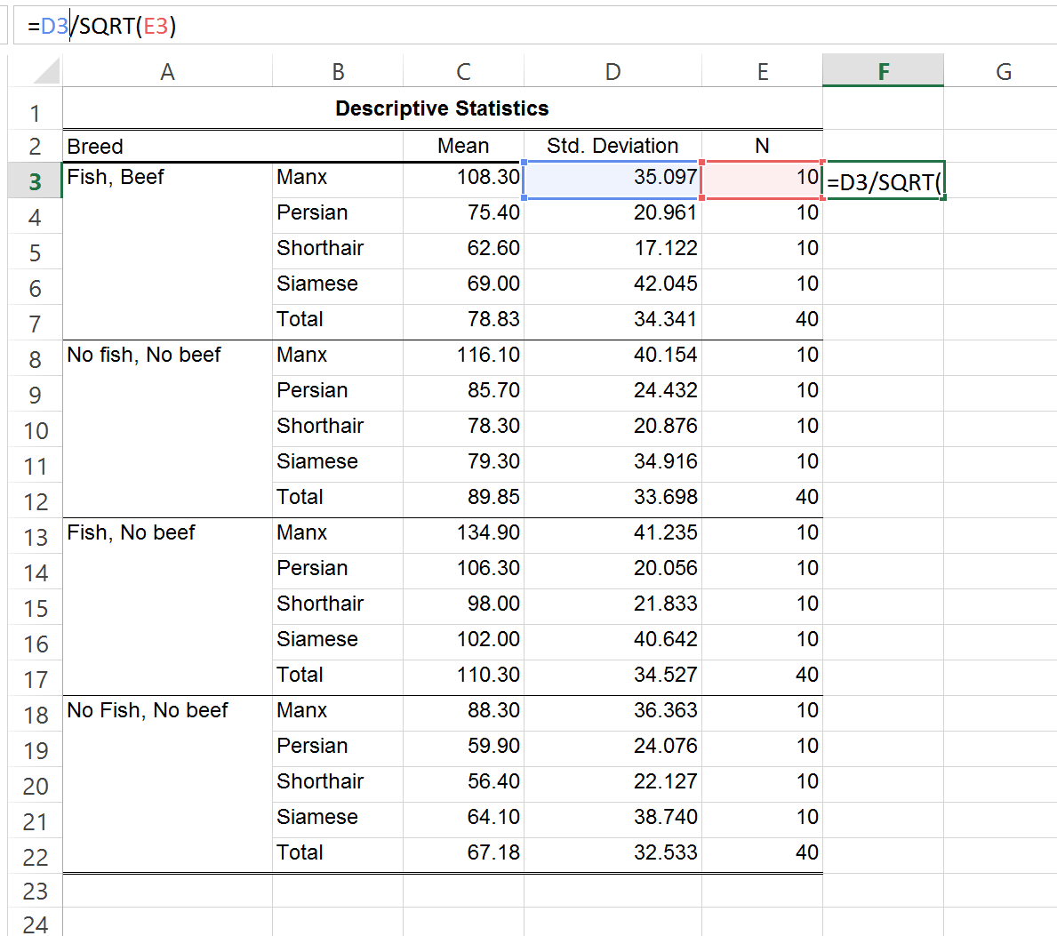
Prepare table in Excel
You need to add a column for the Standard error of the mean.
Remember the formula? It’s standard deviation / square root of the sample size
In a new column in Excel, enter that formula (in this case, it should be =D3/SQRT(E3)
Press ENTER, then double-click the little square at the lower-right corner of the cell

Slide 25
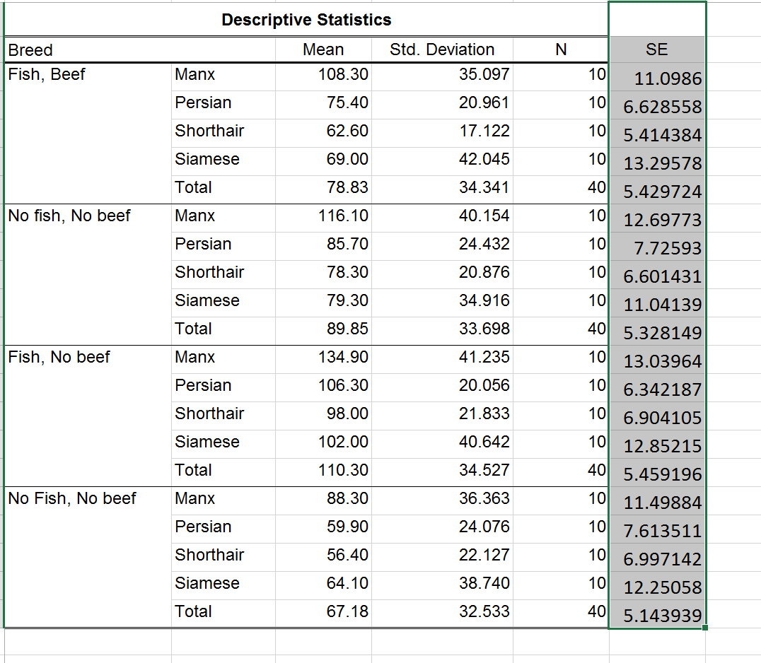
Prepare table in Excel
Now just fix the formatting (Right-click + Format cells…)
Set Number format to Number with 2 decimal places
Add the horizontal lines (Format cells → Border)
Align the “Breed” label by unclicking “Merge and Center”
When you’re done, copy and paste this table to Word.
Don’t forget to add a caption!

Slide 26
Make plots
In SPSS, go to Graphs → Legacy Dialogs → Bar…

Slide 27
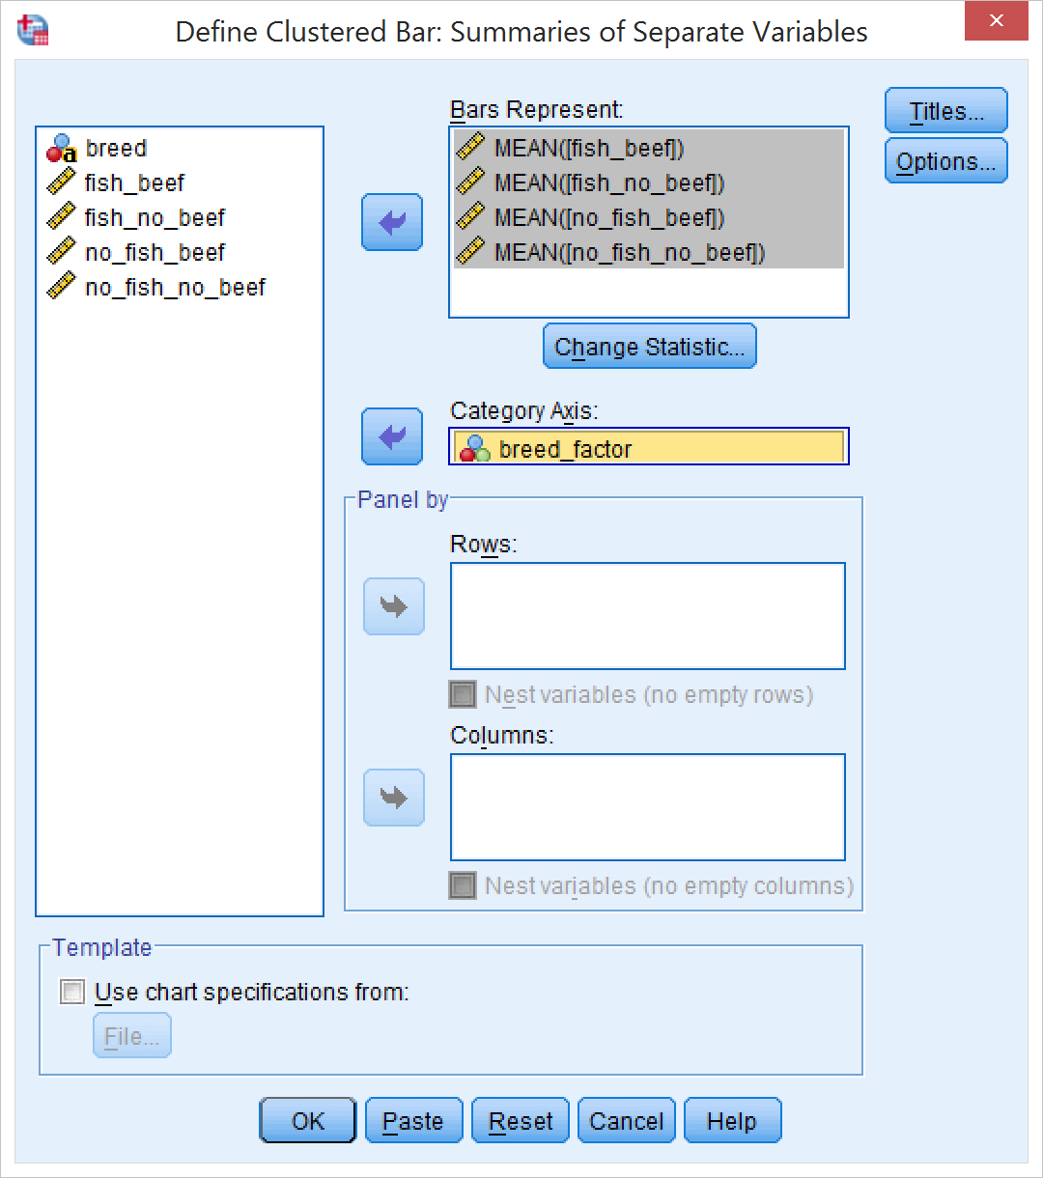
Make plots
Assign the four different beef/fish columns to “Bars represent”
The default statistic (“MEAN”) is exactly what we want
Assign the between-subject factor (“breed_factor”) to “Category Axis”

Slide 28
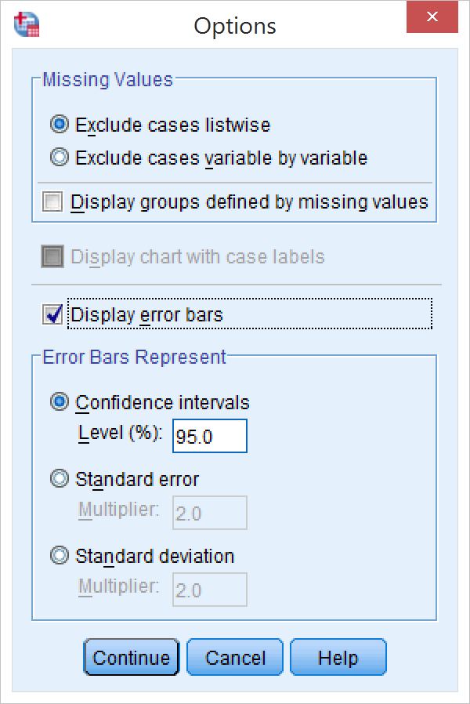
Add error bars
Click “Options…”
Check “Display error bars”
The default setting (95% CI) is what we want.
Click “Continue”

Slide 29
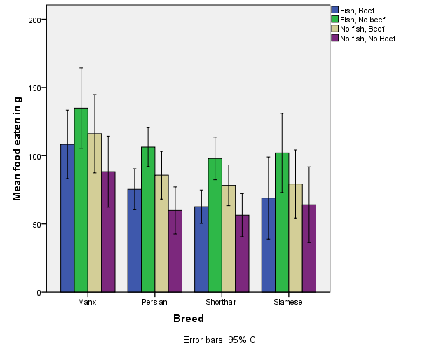
Final touches
Double-click the resulting graph to open it in the chart editor
Double-click axis and legend labels to edit them and make them look nice
There we go!

Slide 30
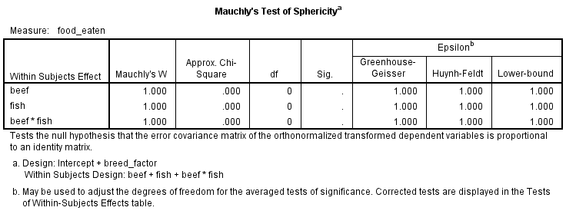
The hypothesis tests
Do NOT copy and paste any SPSS output directly
Look at the tables and pick out the correct numbers
First, for the within subjects effects, look at Mauchly’s test of sphericity
In this case, there is no Sig value, since neither beef nor fish have more than 2 levels
If one of the tests is significant, check the Greenhouse-Geisser Epsilon
If it’s over .75, use the Huynh-Feldt Epsilon to correct for sphericity
If it’s under .75, use the G-G Epsilon

Slide 31
The hypothesis tests
The results of the F-tests on the Within-Subjects factors are in the “Tests of Within-Subjects Effects” table
In the “Sig.” column, check which p-values are below .05
You have to report those effects in detail
The correct error term is the first one listed below the predictor
If you need to make a sphericity correction, pick the correct row (see last slide), otherwise use the values from the row “Sphericiy assumed”

Slide 32
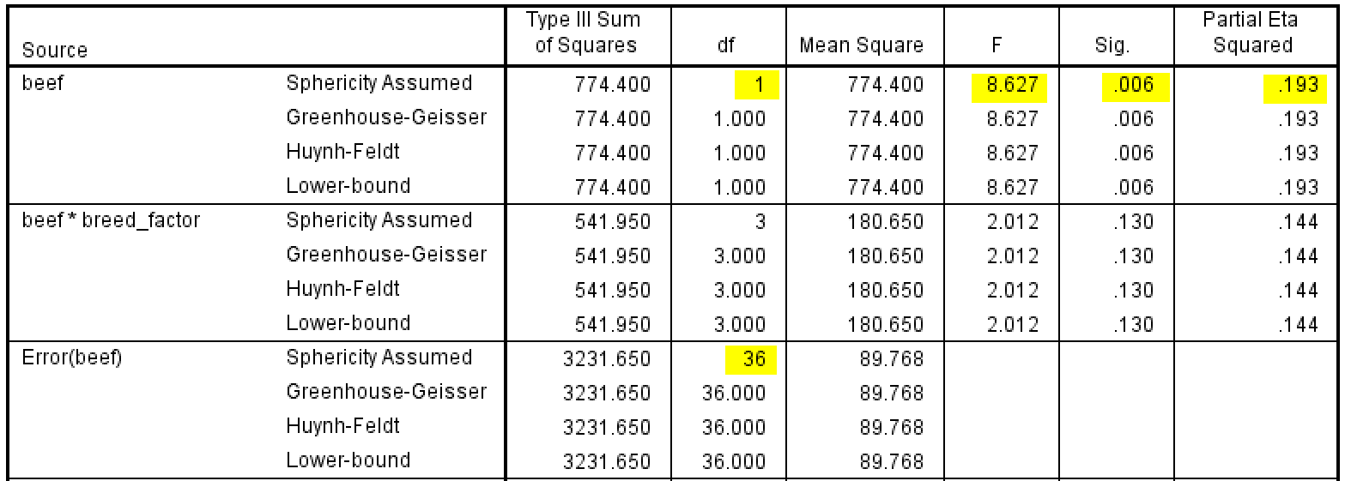
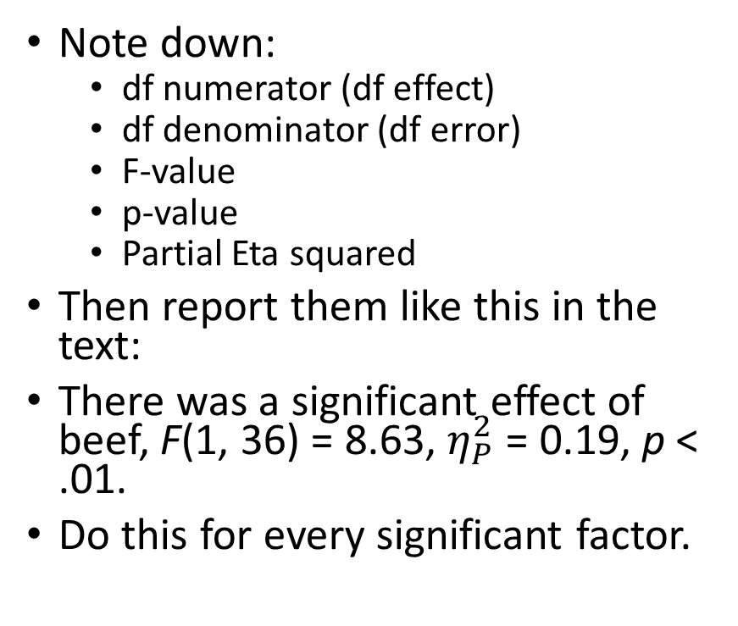
The hypothesis tests
Note down:
df numerator (df effect)
df denominator (df error)
F-value
p-value
Partial Eta squared
Then report them like this in the text:
There was a significant effect of beef, F(1, 36) = 8.63, $η_{P}^{2}$ = 0.19, p < .01.
Do this for every significant factor.

Slide 33
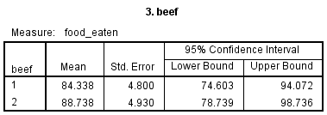
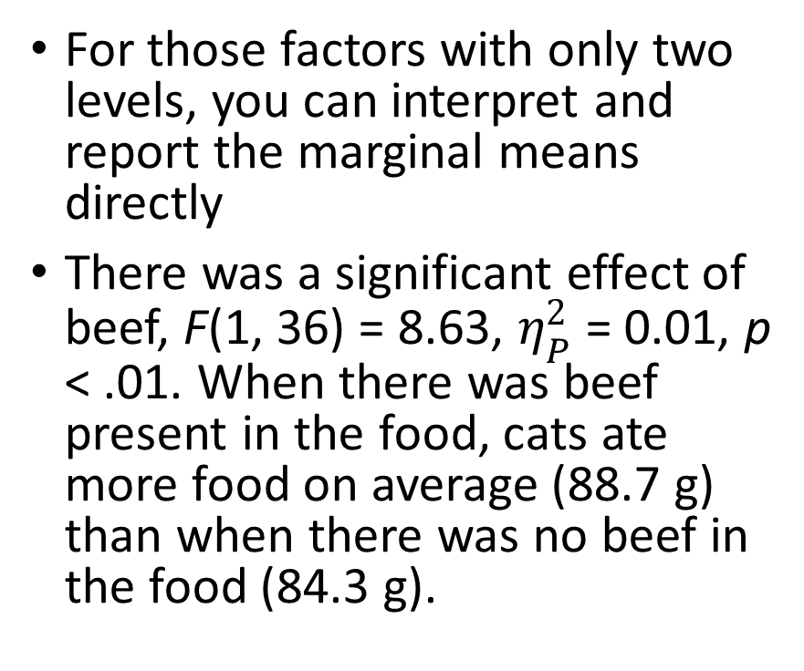
The hypothesis tests
For those factors with only two levels, you can interpret and report the marginal means directly
There was a significant effect of beef, F(1, 36) = 8.63, $η_{P}^{2}$ = 0.01, p < .01. When there was beef present in the food, cats ate more food on average (88.7 g) than when there was no beef in the food (84.3 g).

Slide 34
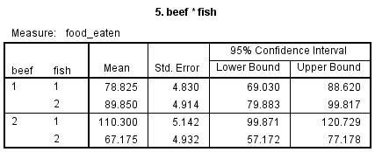
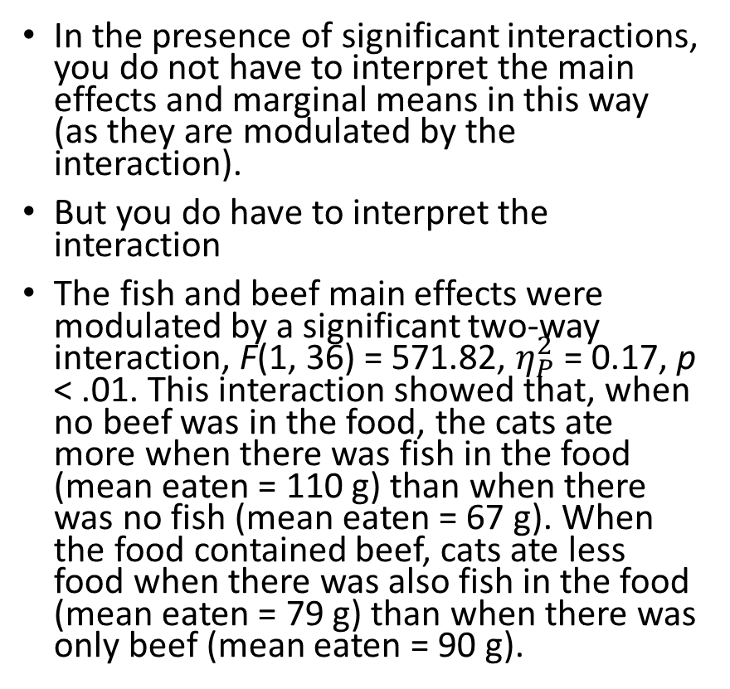
The hypothesis tests
In the presence of significant interactions, you do not have to interpret the main effects and marginal means in this way (as they are modulated by the interaction).
But you do have to interpret the interaction
The fish and beef main effects were modulated by a significant two-way interaction, F(1, 36) = 571.82, $η_{P}^{2}$ = 0.17, p < .01. This interaction showed that, when no beef was in the food, the cats ate more when there was fish in the food (mean eaten = 110 g) than when there was no fish (mean eaten = 67 g). When the food contained beef, cats ate less food when there was also fish in the food (mean eaten = 79 g) than when there was only beef (mean eaten = 90 g).
Note that no pairwise comparisons are needed when both factors in the interaction only have two levels

Slide 35
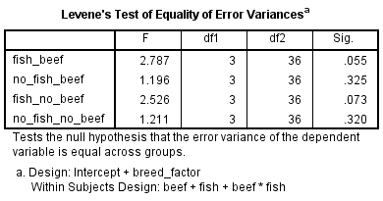
Assumption tests
Mauchly’s test (see previous slides)
Levene’s test
See table in the output
Note that this is split by within-subject conditions
Report if one or more of the tests are significant

Slide 36
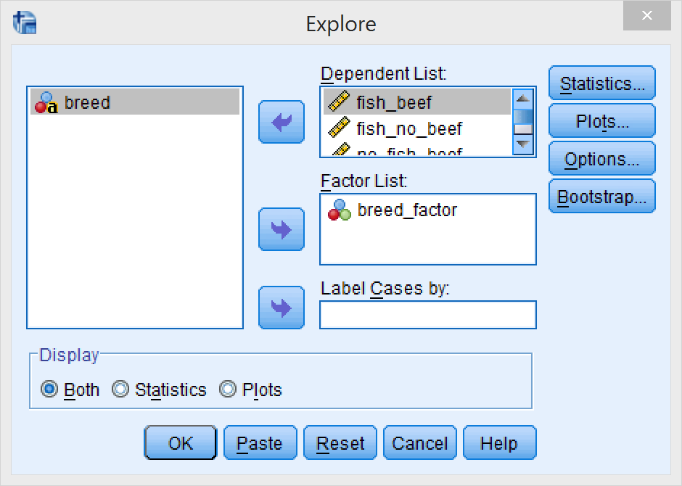
Assumption tests
Normality
Surprisingly involved!
Go to Analyze → Descriptive Statistics → Explore…
Move all within-subjects columns to “Dependent List”
Move the between-subjects factor to “factor list”
Click on “Options…”

Slide 37
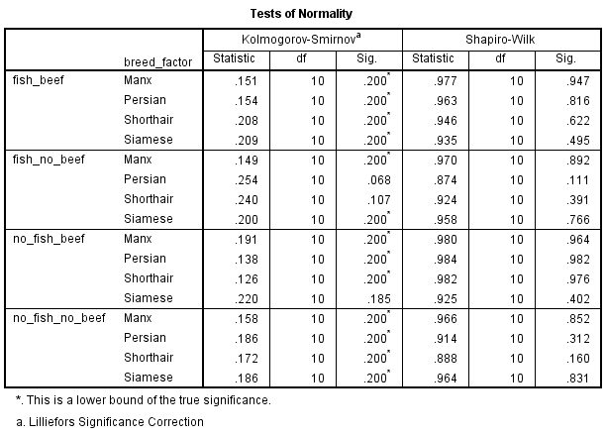
Assumption tests
Check “Normality plots with tests”
Click “Continue”
Click “OK”
Check the resulting table for p-values below .05
If there are any, report them.

Slide 38
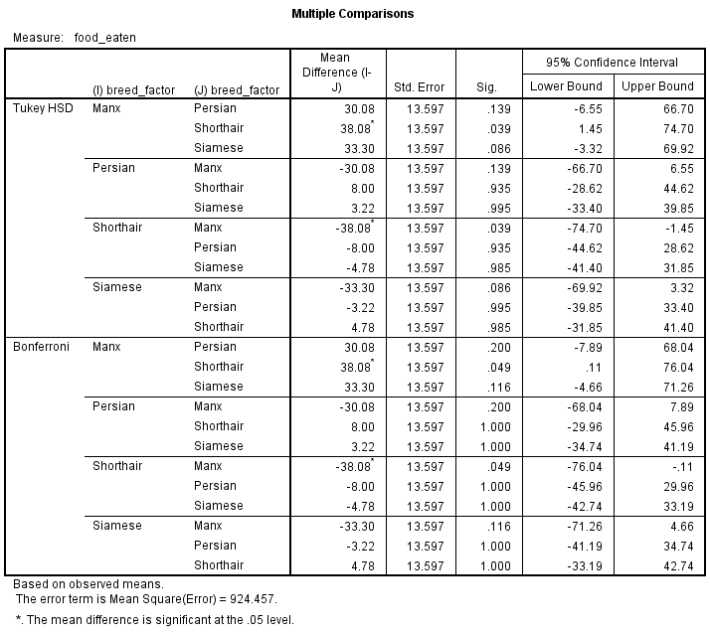
Post-hoc tests
Look at the “Multiple Comparisons” table
Choose the test with the highest power (Tukey’s in this case)
Check Sig column for < .05
Report those effects along with the means

Slide 39
Writing things up
Refer to the “Homework 4 worked.docx” file for guidance.

